Slide 1
How A.I. Works
and why data is important
(in 60 minutes)
With slides from Chris Piech

Slide 2
Where is my robot?

Slide 3
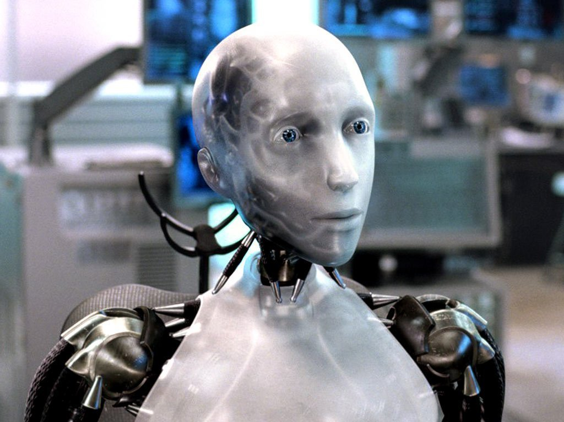
Sci-Fi Has Promised Me Robots

Slide 4
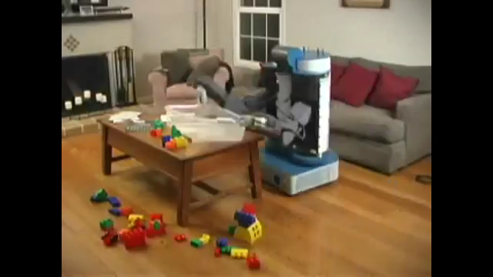
House Cleaning Robot

Slide 5
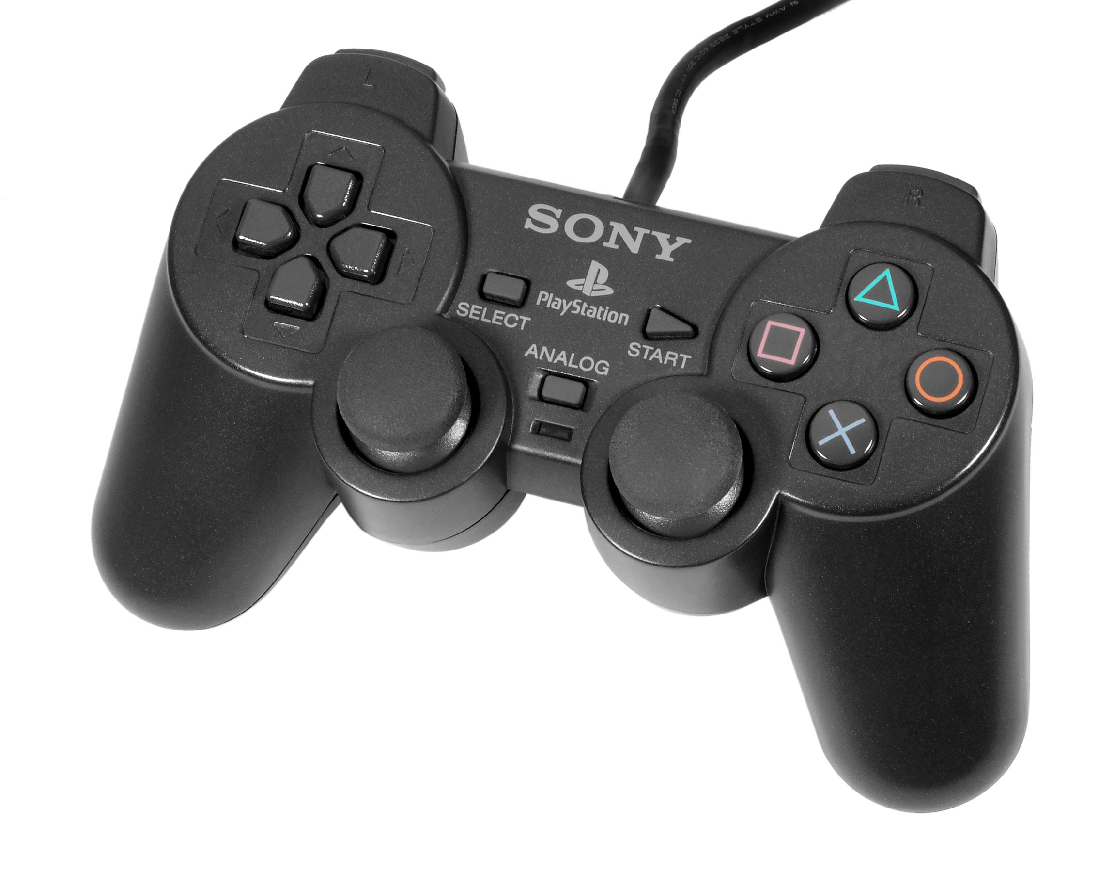
House Cleaning Robot

Slide 6
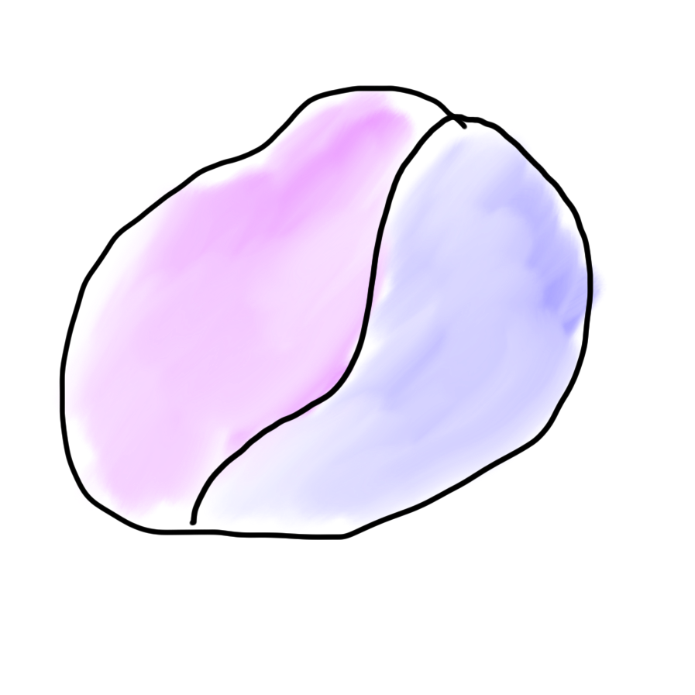
Robots?
Mind
Body

Slide 7

Robots?
Mind
Body

Slide 8
What is AI?

Slide 9
[suspense]

Slide 10
AI: The study and design of intelligent agents

Slide 11
Computer
programs
AI: The study and design of intelligent agents
Better than
chance
As well as
humans

Slide 12
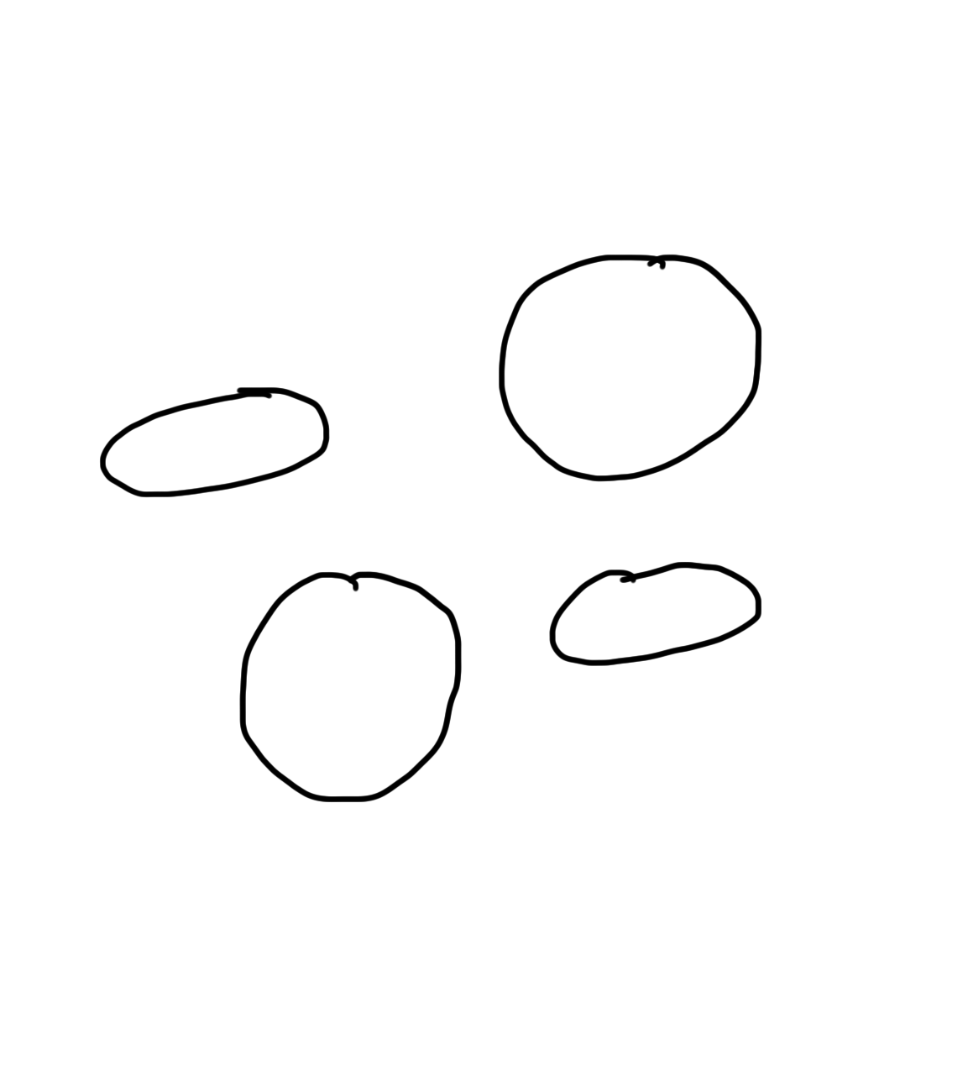
Narrow Intelligence
Translate
Turkish
Play Chess
Play Breakout
Drive a
Car

Slide 13
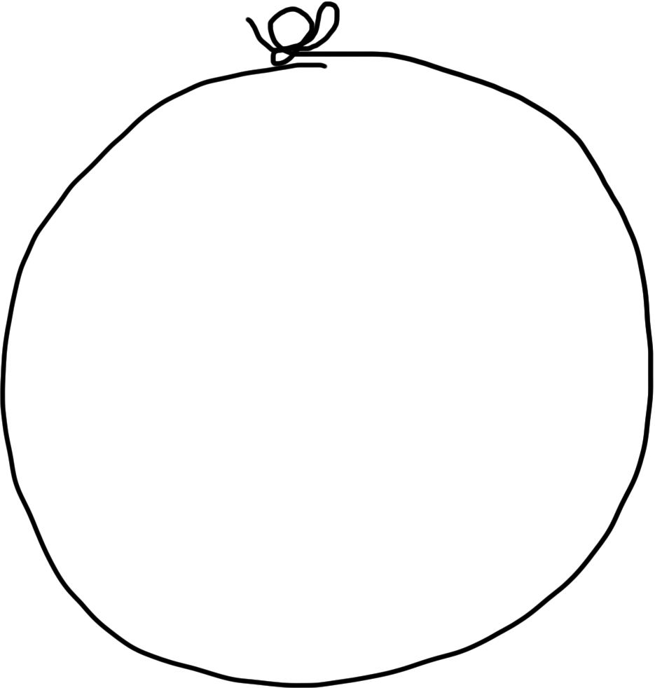
General Intelligence
Translate
Turkish
Play Chess
Play Breakout
Drive a
Car

Slide 14
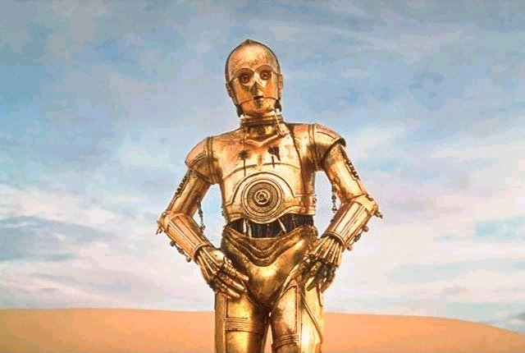
Brief History

Slide 15
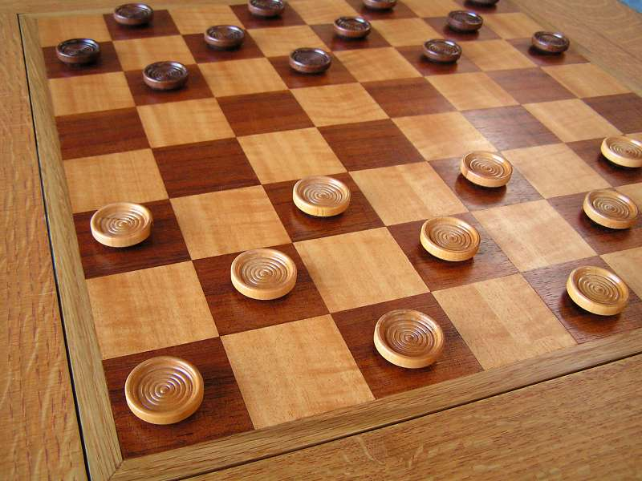
Early Optimism 1950s
1952

Slide 16
Early Optimism (1950s)
“Machines will be capable, within twenty years, of doing any work a man can do.”
–Herbert Simon, 1952

Slide 17
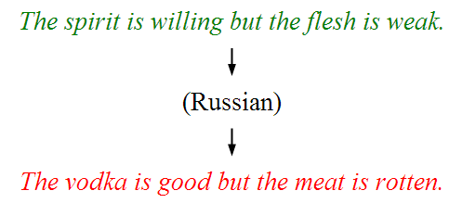
Underwhelming Results (1950s–1980s)
The world is too complex

Slide 18



Modern Game of AI

Slide 19

Told Speech Was 30 Years Out
Almost perfect…
Notes:
https://twitter.com/kid_chrissy/status/1082472189725687808

Slide 20
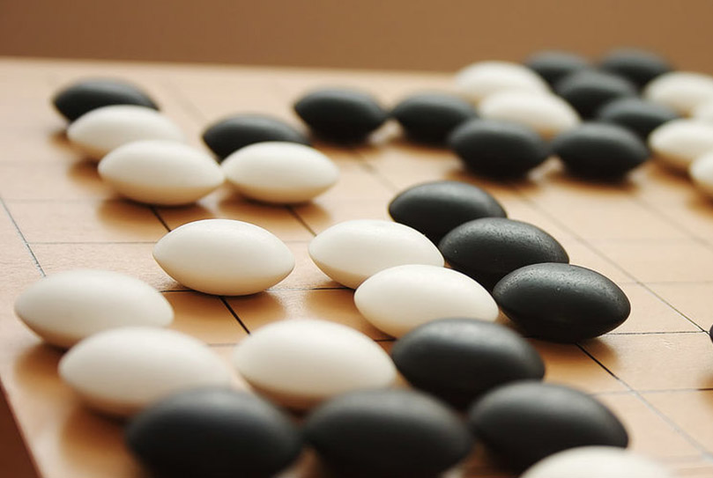
The Last Remaining Board Game

Slide 21
Computers Making Art

Slide 22
Self-driving Cars

Slide 23
What is going on?

Slide 24
[more suspense]

Slide 25
Story of Modern AI

Slide 26
Focus on one problem

Slide 27
Make a Harry Potter Sorting Hat

Slide 28

Classification
Logistic Regression is like the Harry Pottery Sorting Hat
That is a picture
of a one

Slide 29

Classification
Logistic Regression is like the Harry Pottery Sorting Hat
That is a picture
of a zero

Slide 30

Classification
That is a picture
of an zero
* It doesn’t have to be correct all of the time

Slide 31
Can you do it?

Slide 32

What number is this?

Slide 33

What number is this?

Slide 34

How about now?
What a computer sees
0 | 0 | 1 | 0 | 1 | 0 | 1 | 0 | 0 | 0 | 1 | 1 | 1 | 0 | 1
1 | 0 | 0 | 1 | 0 | 1 | 1 | 1 | 0 | 1 | 0 | 0 | 0 | 0 | 0
1 | 1 | 1 | 0 | 1 | 0 | 0 | 1 | 1 | 0 | 0 | 1 | 0 | 1 | 0
1 | 1 | 1 | 1 | 1 | 0 | 0 | 0 | 0 | 0 | 1 | 1 | 0 | 1 | 1
0 | 0 | 0 | 1 | 1 | 0 | 0 | 1 | 0 | 0 | 0 | 1 | 1 | 1 | 0
1 | 0 | 0 | 1 | 1 | 0 | 0 | 0 | 1 | 0 | 1 | 1 | 1 | 1 | 0
1 | 1 | 0 | 1 | 1 | 0 | 0 | 1 | 1 | 0 | 1 | 1 | 1 | 0 | 0
1 | 0 | 1 | 0 | 0 | 1 | 0 | 0 | 1 | 0 | 0 | 1 | 1 | 1 | 1
0 | 0 | 0 | 0 | 1 | 0 | 1 | 0 | 1 | 1 | 0 | 0 | 1 | 1 | 1
0 | 1 | 1 | 0 | 0 | 0 | 0 | 0 | 1 | 1 | 1 | 1 | 1 | 1 | 0
0 | 0 | 1 | 0 | 1 | 1 | 1 | 0 | 0 | 0 | 1 | 0 | 0 | 0 | 0
0 | 1 | 1 | 1 | 0 | 1 | 0 | 0 | 1 | 0 | 0 | 0 | 0 | 0 | 1
1 | 1 | 0 | 0 | 0 | 0 | 0 | 0 | 0 | 0 | 1 | 0 | 0 | 1 | 1
0 | 0 | 0 | 0 | 0 | 0 | 0 | 0 | 1 | 1 | 1 | 1 | 0 | 0 | 1
0 | 0 | 1 | 1 | 1 | 0 | 1 | 0 | 1 | 1 | 0 | 0 | 0 | 1 | 0
What a human sees

Slide 35
Why is it easy for Humans?
About 30% of your cortex is used from vision
3% is used to process hearing

Slide 36
Very hard to Program
??
public class HarryHat extends ConsoleProgram {
public void run() {
println("Todo: Write program");
}
}

Slide 37
Perhaps there is an insight?

Slide 38
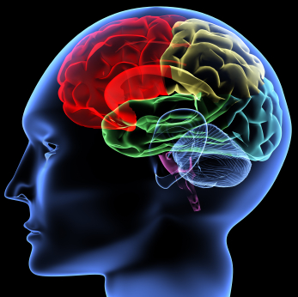
One Algorithm Hypothesis
Much of perception in the brain can be explained with a single learning algorithm.
[Andrew Ng]

Slide 39

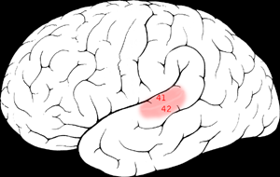

One Algorithm Hypothesis
Auditory Cortex
Auditory cortex learns to see
[Roe et al., 1992]
[Andrew Ng]

Slide 40
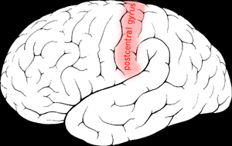

One Algorithm Hypothesis
Somatosensory Cortex
Somatosensory cortex learns to see
[Metin & Frost, 1989]
[Andrew Ng]

Slide 41
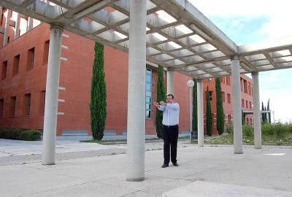
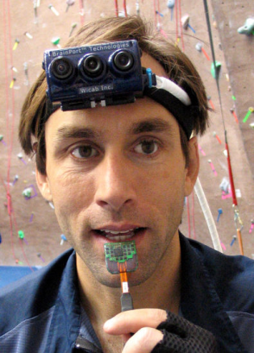
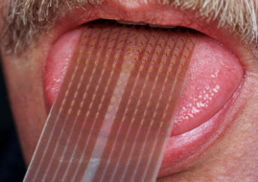
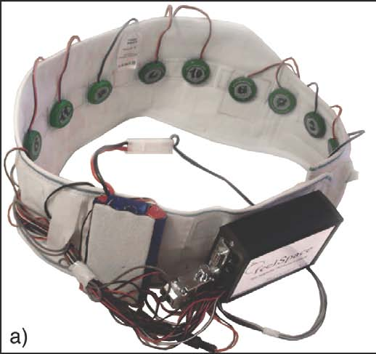
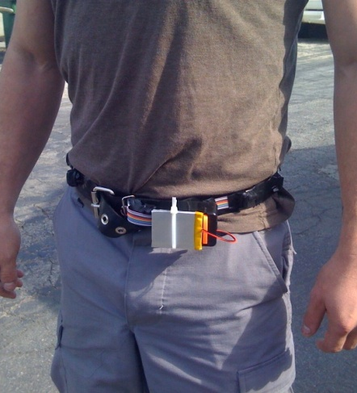
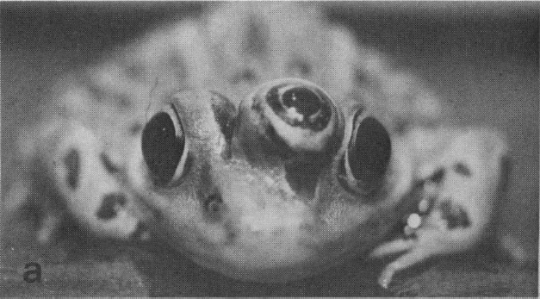
Sensor Representations
Seeing with your tongue
Human echolocation (sonar)
Haptic belt: Direction sense
Implanting a 3rd eye
[BrainPort; Welsh & Blasch, 1997; Nagel et al., 2005; Constantine-Paton & Law, 2009]

Slide 42
Two Great Ideas
1. Artificial Neurons
2. Learn by Example

Slide 43
Two Great Ideas
1. Artificial Neurons
2. Learn by Example

Slide 44
1. Artificial Neurons

Slide 45
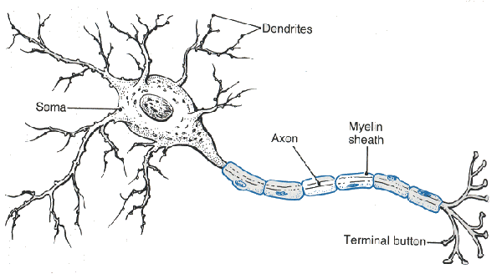
Neuron

Slide 46
Neuron

Slide 47
Neuron

Slide 48
Neuron

Slide 49
Neuron

Slide 50
Some Inputs are More Important

Slide 51
Artificial Neuron

Slide 52

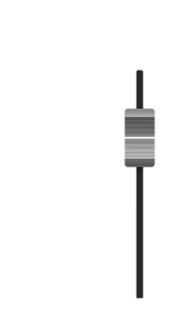

Inputs
+

Slide 53
Inputs
+

Slide 54
Inputs
+

Slide 55
Weights
+

Slide 56
Weights
+

Slide 57
Weights
+

Slide 58
Weighted Sum
+
double weightedSum = 0;
weightedSum = weightedSum + input0 * weight0;
weightedSum = weightedSum + input1 * weight1;
weightedSum = weightedSum + input2 * weight2;
weightedSum = weightedSum + input3 * weight3;

Slide 59
Filter and Output
+

Slide 60
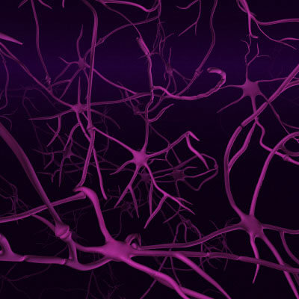
Biological Basis
A neuron
Your brain
(actually, probably someone else’s brain)
???

Slide 61
Put Many Together
+
+
+
+

Slide 62
Put Many Together
Input Neurons
Hidden Neurons
Output Neurons

Slide 63
Making a Prediction
…
Input Neurons
Hidden Neurons
Output Neurons

Slide 64
Making a Prediction
…
Input Neurons
Hidden Neurons
Output Neurons

Slide 65
Making a Prediction
…
Input Neurons
Hidden Neurons
Output Neurons

Slide 66
Making a Prediction
I think that is a picture of a one!
…
Input Neurons
Hidden Neurons
Output Neurons

Slide 67
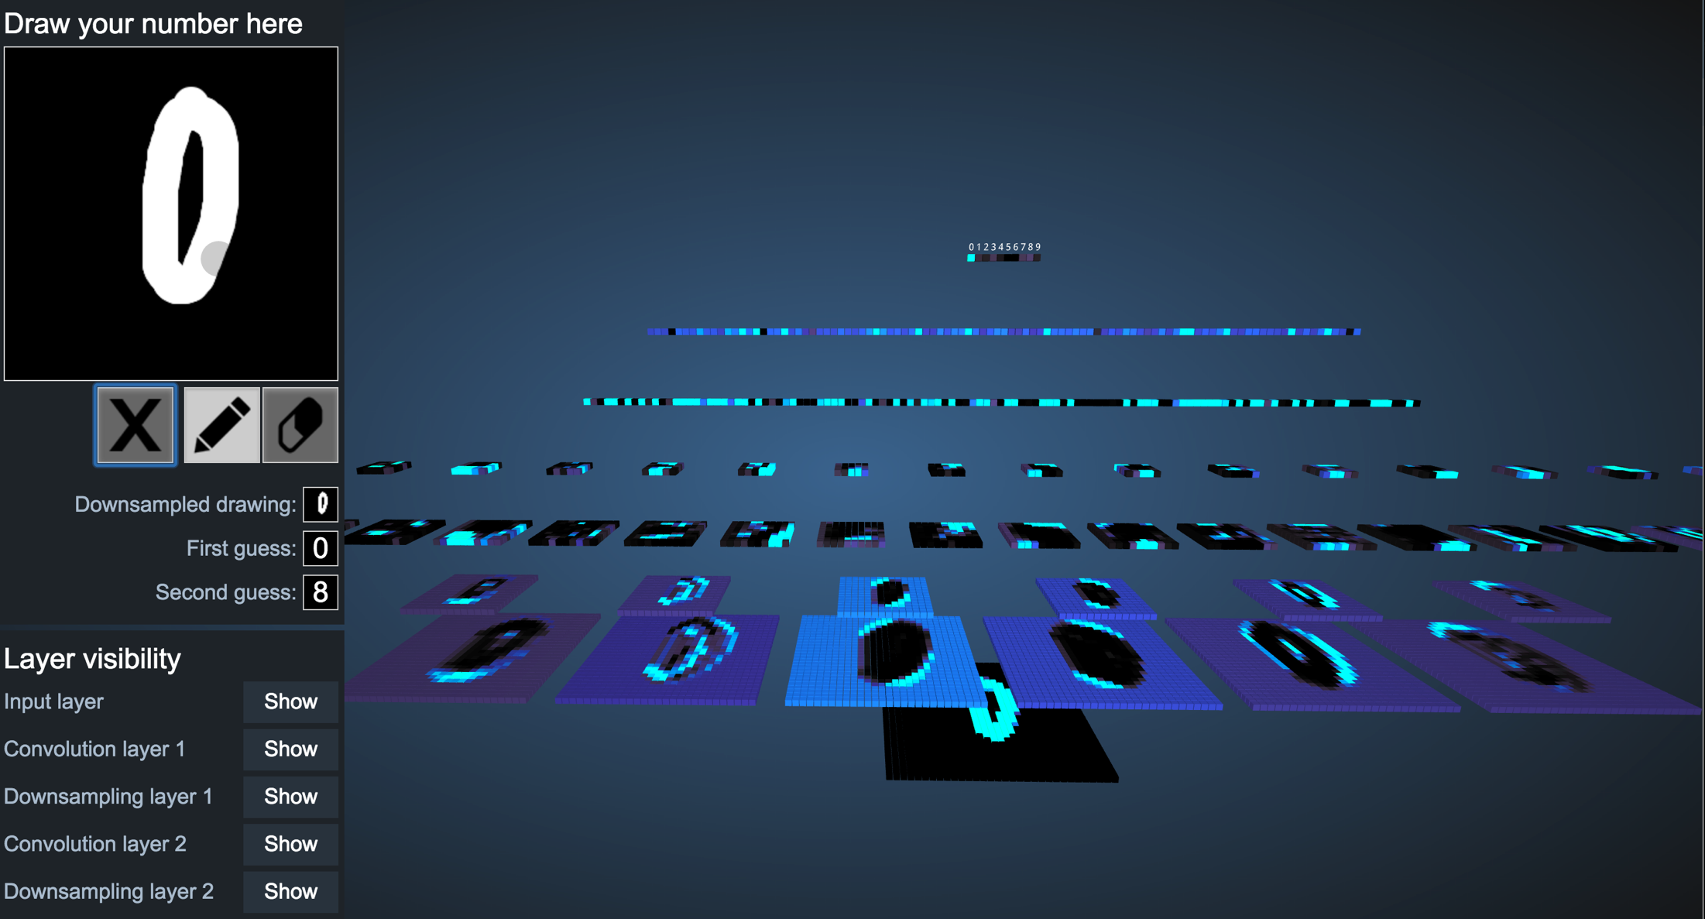
Demonstration
http://scs.ryerson.ca/~aharley/vis/conv/

Slide 68
Great Idea: Artificial Neurons

Slide 69
Two Great Ideas
1. Artificial Neurons
2. Learn by Example

Slide 70
Two Great Ideas
1. Artificial Neurons
2. Learn by Example

Slide 71
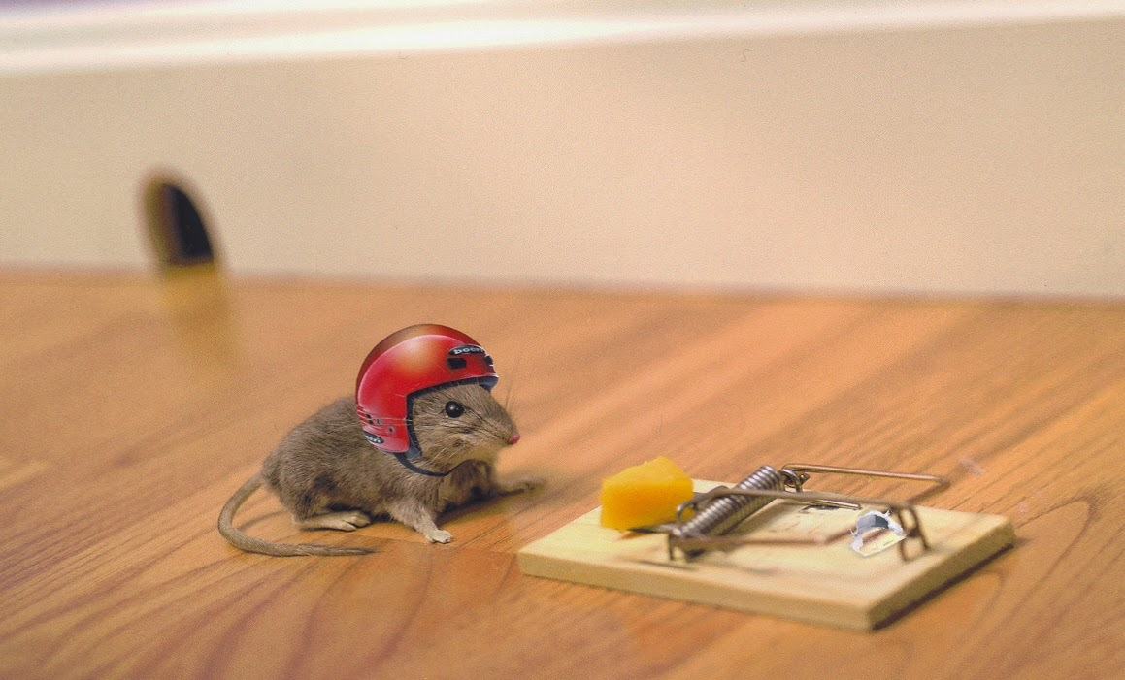
2. Learn From Experience

Slide 72
Neural Networks gets their intelligence from its sliders (aka its parameters)

Slide 73
Neural Network
Input Neurons
Hidden Neurons
Output Neurons

Slide 74
Neural Network
+
+
+
+

Slide 75

Learn by Example

Slide 76
+

Slide 77
I think that is a picture of a one!
+
Oh what, it’s a zero??
Ill adjust my sliders so that I do better.

Slide 78
I think that is a picture of a one!
+
Oh what, it’s a zero??
Ill adjust my sliders so that I do better.

Slide 79
+

Slide 80
+

Slide 81
I think that is a picture of a one!
+
Woohoo, I got it right!!

Slide 82
+

Slide 83
I think that is a picture of a zero!
+
Oh what, it’s a one??
I’ll adjust my sliders so that I do better.

Slide 84
I think that is a picture of a zero!
+
Oh what, it’s a one??
I’ll adjust my sliders so that I do better.

Slide 85
Study Hard!

Slide 86
Train on Faces

Slide 87


Visualize the Sliders
object models
object parts
(combination
of edges)
Training set: Aligned
images of faces.
edges
pixels
[Honglak Lee]

Slide 88
Woah… that’s like a brain…

Slide 89
True.

Slide 90
Decomposition
Mountain Karel
Climb Up Mountain
Step Up
Pick Beeper
Climb Down Mountain
Step Down
Notes:
He looks like an old machintosh machine.
Hes got legs… one sticks out the back. That’s just the way it is.

Slide 91
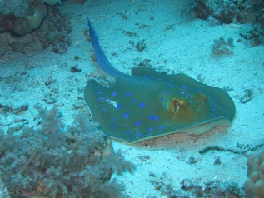
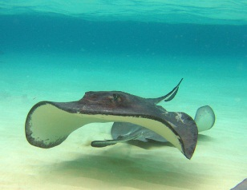
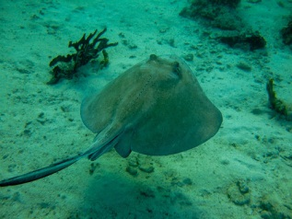
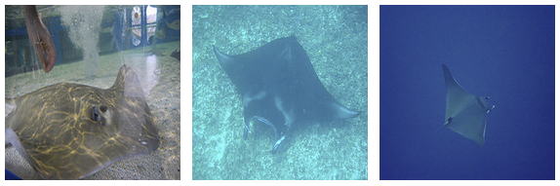

ImageNet Decomposition
…
smoothhound, smoothhound shark, Mustelus mustelus
American smooth dogfish, Mustelus canis
Florida smoothhound, Mustelus norrisi
whitetip shark, reef whitetip shark, Triaenodon obseus
Atlantic spiny dogfish, Squalus acanthias
Pacific spiny dogfish, Squalus suckleyi
hammerhead, hammerhead shark
smooth hammerhead, Sphyrna zygaena
smalleye hammerhead, Sphyrna tudes
shovelhead, bonnethead, bonnet shark, Sphyrna tiburo
angel shark, angelfish, Squatina squatina, monkfish
electric ray, crampfish, numbfish, torpedo
smalltooth sawfish, Pristis pectinatus
guitarfish
roughtail stingray, Dasyatis centroura
butterfly ray
eagle ray
spotted eagle ray, spotted ray, Aetobatus narinari
cownose ray, cow-nosed ray, Rhinoptera bonasus
manta, manta ray, devilfish
Atlantic manta, Manta birostris
devil ray, Mobula hypostoma
grey skate, gray skate, Raja batis
little skate, Raja erinacea
…
Stingray
Mantaray

Slide 92
0.005%
1.5%
Random guess
Pre Neural Networks (2012)
43.9%
66.3%
GoogLeNet (2015)
2016
Le, et al., Building high-level features using large-scale unsupervised learning. ICML 2012
Szegedy et al, Going Deeper With Convolutions, CVPR 2015
http://image-net.org/challenges/LSVRC/2016/results

Slide 93

Google Brain
1 Trillion Artificial Neurons
(btw, human brains have 1 billion neurons)

Slide 94
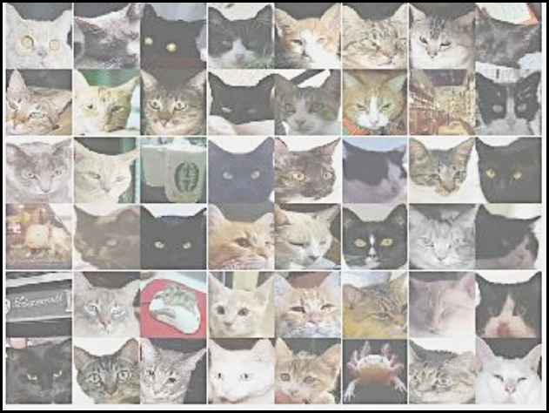

A Neuron That Fires When It Sees Cats
Top stimuli from the test set
Optimal stimulus
by numerical optimization
Le, et al., Building high-level features using large-scale unsupervised learning. ICML 2012

Slide 96





Other Neurons
Neuron 1
Neuron 2
Neuron 3
Neuron 4
Neuron 5
Le, et al., Building high-level features using large-scale unsupervised learning. ICML 2012
Input to another layer above
(image with 8 channels)
Number of output
channels = 8
LCN Size = 5
H
Pooling Size = 5
Number
of maps = 8
One layer
W
RF size = 18
Number of input
channels = 3
Image Size = 200

Slide 97
The Future of AI
Einstein
Human Intelligence
Performance
Complex Programs
Machine Learning
Time
Now
2012
Notes:
NVIDIA or ATI will be future of AI. Probably NVIDIA.

Slide 98
What’s the catch?

Slide 99
(1) Machine Learning Needs Data

Slide 100
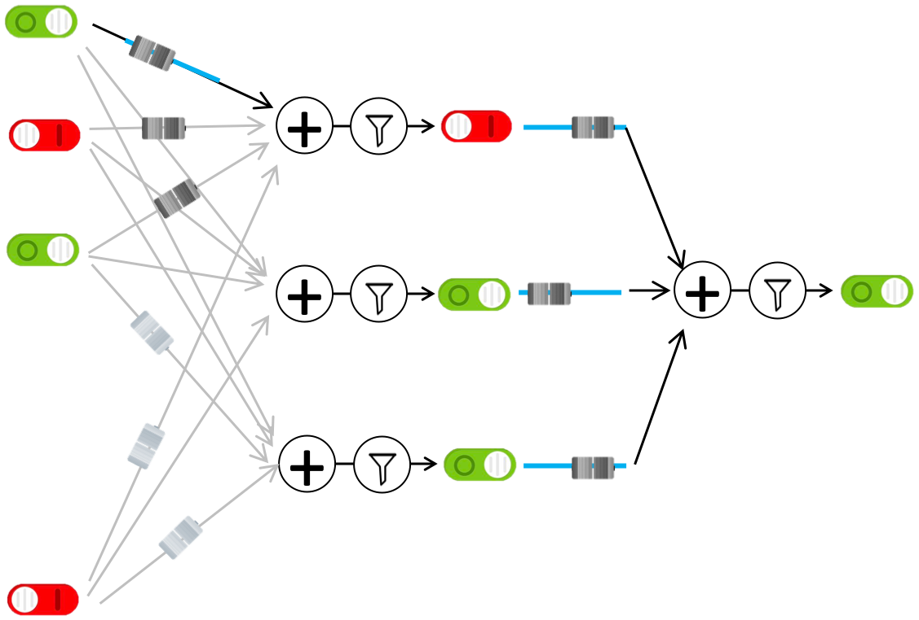
(1) Machine Learning Needs Data
(1) Get Data
(2) Train computer
Compiled by humans
Math and logic

Slide 101
(1) Machine Learning Needs Data
TODO
Google Translate example?

Slide 102
(1) Machine Learning Needs Data
Input: Speech recording
Output: Captions
(2) Train computer
(1) Get Data
Female speaker error >
Male speaker error

Slide 103
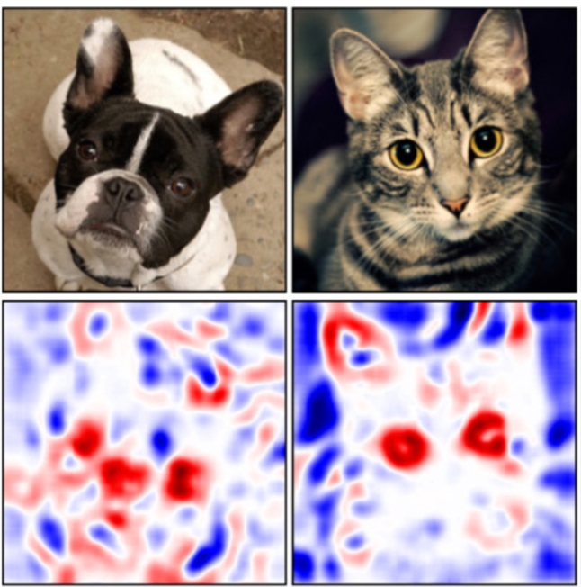
(2) How can we explain decisions?
Zintgraf et al., Visualizing Deep Neural Network Decisions: Prediction Difference Analysis, ICLR 2017

Slide 104
(2) How can we explain decisions?
That is a picture of a one!
??
black box
(probably fine)

Slide 105
(2) How can we explain decisions?
This person is dangerous!
??
black box
(not fine)

Slide 106
(3) How can we make it fair?
Should algorithm bias reflect social bias?
Bolukbasi et al., Man is to Computer Programmer as Woman is to Homemaker? Debiasing Word Embeddings, NIPS 2016
Dataset: Google News

Slide 107
Where is my robot?
… coming soon

Slide 108

You can help
Little math

Slide 109
Can you do it?
(I explained to you the main components)
Not easy…
But yes. You can.

Slide 110

Path to AI

Slide 111
Why?

Slide 112

Closest Thing To Magic

Slide 113
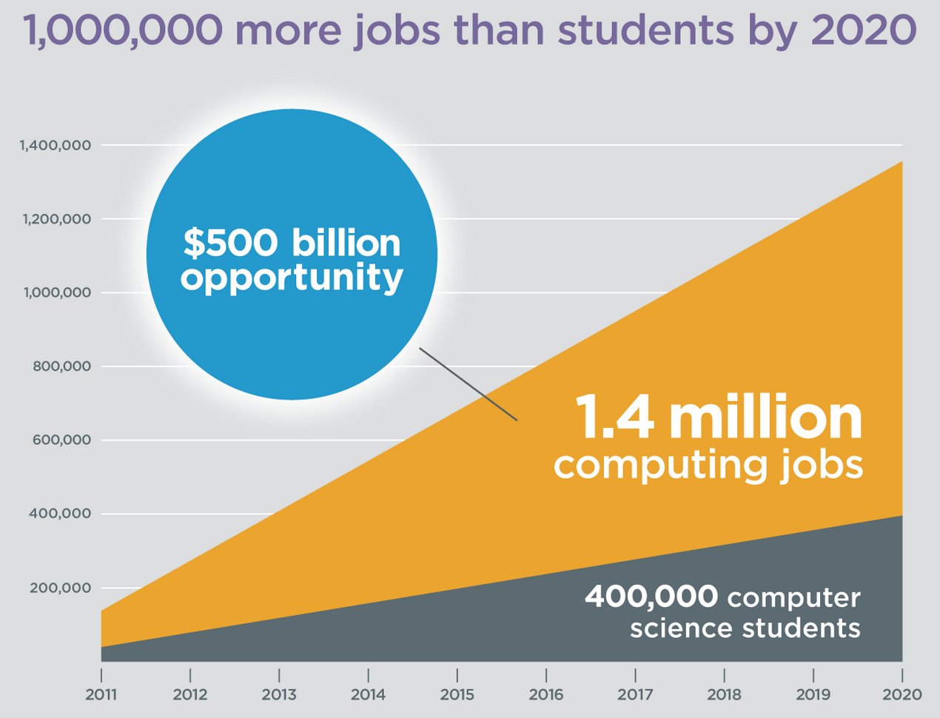
It’s Useful
Code.org

Slide 114
It needs your input

Slide 115

(make it so that) Everyone is Welcome

Slide 116
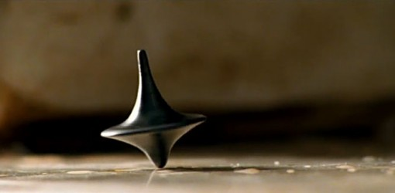
The End?

